Slide 1





HACKATHON 4.O
"FOR MINDS THAT INNOVATE"
"UNVEIL YOUR VISION"
Team Name: Pseudo Coders
Team ID: HACK25-115

Slide 2
Problem Statement - 48
Disasters can occur unexpectedly, and individuals often lack timely and accurate information to respond effectively. There is a need for a tool that analyzes real-time data from multiple sources to identify potential disasters and provide early warnings, ensuring public safety.

Slide 3
Solution
What did you understand about the problem statement.
Many disaster detection systems rely on singular data sources, leading to incomplete or delayed alerts. By integrating information from news, social media, government alerts, and weather updates, the system can recognize patterns of emerging disasters and enhance early warning mechanisms.
Develop a tool that gathers and analyzes real-time data from various sources, uses pattern recognition to detect disasters, and provides users with alerts, location-based maps, and safety instructions. This empowers individuals to respond proactively and mitigate risks.

Slide 4




Technology Stack
What tools & technologies you're going to use for the project?
Data Sources: APIs from news agencies, social media, weather services, and government alert systems
APIs : Google API
Data Processing: Machine learning (Pattern Recognition, NLP, Sentiment Analysis)
Language : Python
Backend: Node.js, MongoDB
Frontend: HTML, CSS , JS, React.js

Slide 5
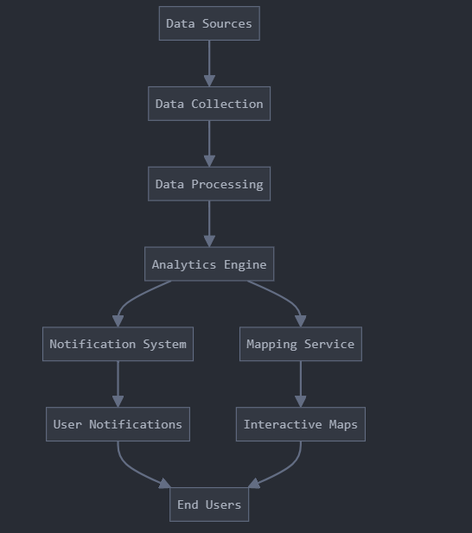

Wireframing/Architecture of the project flow
Data Sources: Origin of raw information
Data Collection: Gathering and initial aggregation
Data Processing: Transforming raw data into usable format
Branching:
Analytics Engine generates insights
Splits into Notification System and Mapping Service
Delivery to End Users:
Notifications communicate key information
Interactive Maps visualize spatial data
The flow ensures data moves efficiently from collection to meaningful user interaction.

Slide 6
Future Scope of the project
Integration with IoT sensors for real-time environmental monitoring.
AI-based predictive analysis for early disaster warnings.
Global partnerships with emergency response organizations.
Offline functionality for areas with low connectivity.
We will create our fully functional disaster detection model

Slide 7
THANK YOU!

